Slide 1
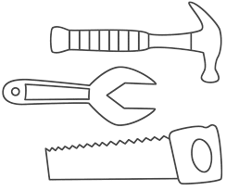
LS2101-Biochemistry
Structure function correlation of Proteins:
Function of each protein is absolutely determined by the its 3D structure

Slide 2
Proteins have evolved in nature to perform specific functions
Functional properties of protein depend upon three-dimensional structure
Functionally active structure of protein arises because of particular sequence of amino acids in polypeptide chains fold to generate compact domains with specific three dimensional structure
Tertiary structure is formed by packing such structural elements into one or several compact globular units called domains
The amino acid sequence of a polypeptide chain is called primary structure
Different regions of the sequence form local regular secondar structures, such as alpha helix or beta strands
The final protein may contain several polypeptide chains arranged in a quaternary structure

Slide 3
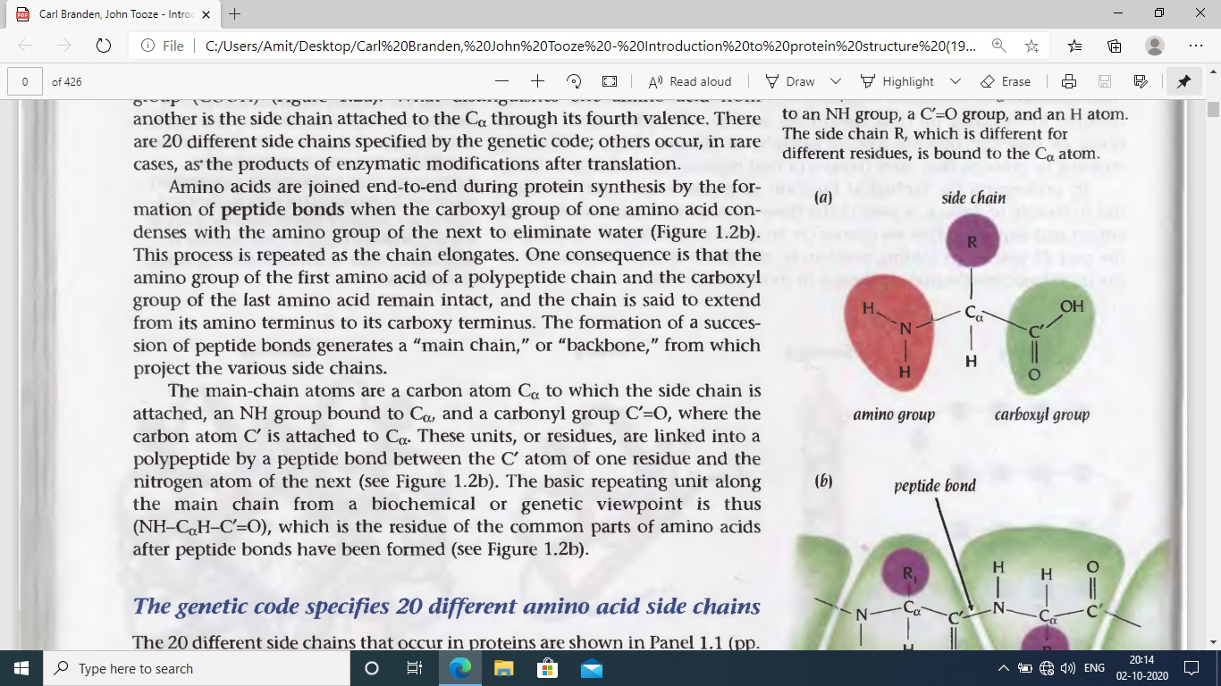
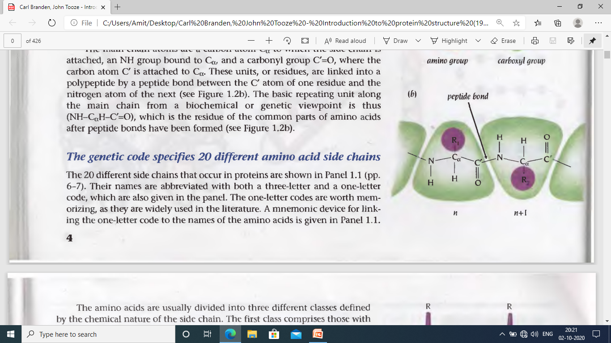
Protein structure
Amino acid – building block
...all amino acids are chiral except glycine
L-form
Amino acids are joined by peptide bond in protein
Repeating unit: amino acid residue

Slide 10
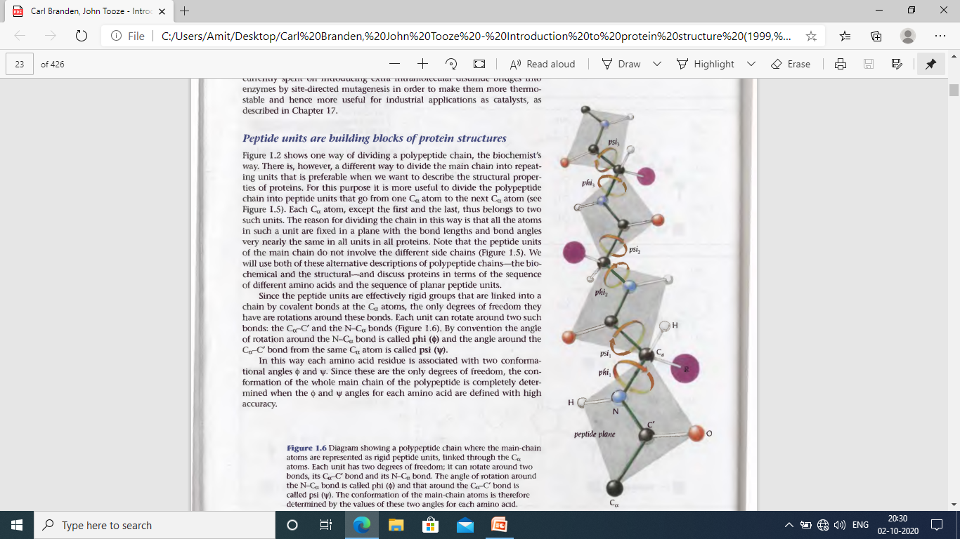
Different way to visualise the polypeptide chain:
Peptide units do not have the side chains
Peptide units are rigid
Each unit can rotate around C_{α} ̶ C’ and N ̶ C_{α} bond
Angle of rotation around N ̶ C_{α} : phi (φ)
Angle of rotation around C_{α} ̶ C’ : psi (ψ)
Each amino acid residue is associated with two conformational angle: φ and ψ
These are the only degrees of freedom that define the conformation of whole main chain

Slide 11
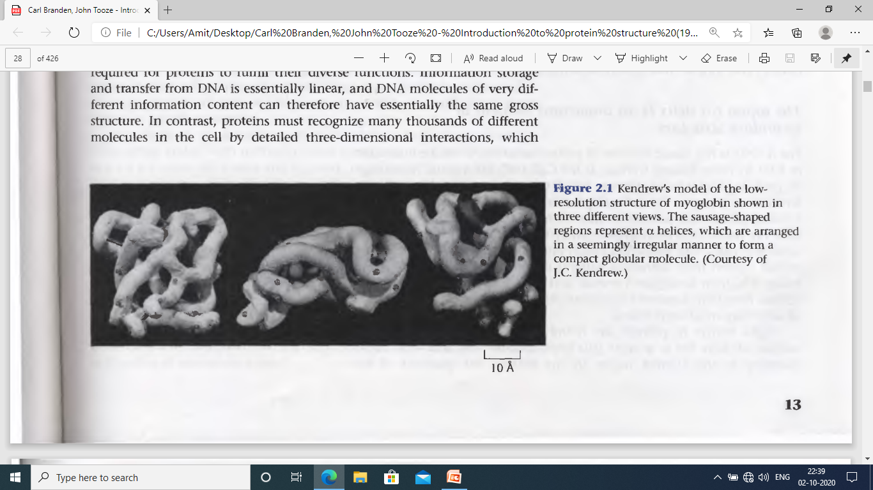
First X-ray crystallographic structure of Protein in 1958: Myoglobin
Sausage shaped region of Myoglobin represents α helices
John Kendrew discovered crystal structure of Myoglobin in 1958……………“Perhaps the most remarkable features of the molecule are its complexity and its lack of symmetry ........... it is more complicated than has been predicted by any theory of protein structure”
=> Such structural irregularity is required for proteins to fulfill their diverse function
The main driving force for folding water soluble protein molecules is to pack hydrophobic side
chains into the interior of the molecule, thus creating hydrophobic core and hydrophilic surface
The main chain is highly polar: one hydrogen bond donar, NH and one hydrogen bond acceptor, C’=O for each peptide unit : Main chain polar groups can be neutralised via H-bonds
The problem can be solved by the formation of two types of secondary structure : α helices and β sheets ⇒ Both types are characterised by hydrogen bonding between main chain NH and C’=O groups
The secondary structure elements, formed in this way and held together by the hydrophobic core, provide a rigid stable frame work

Slide 12
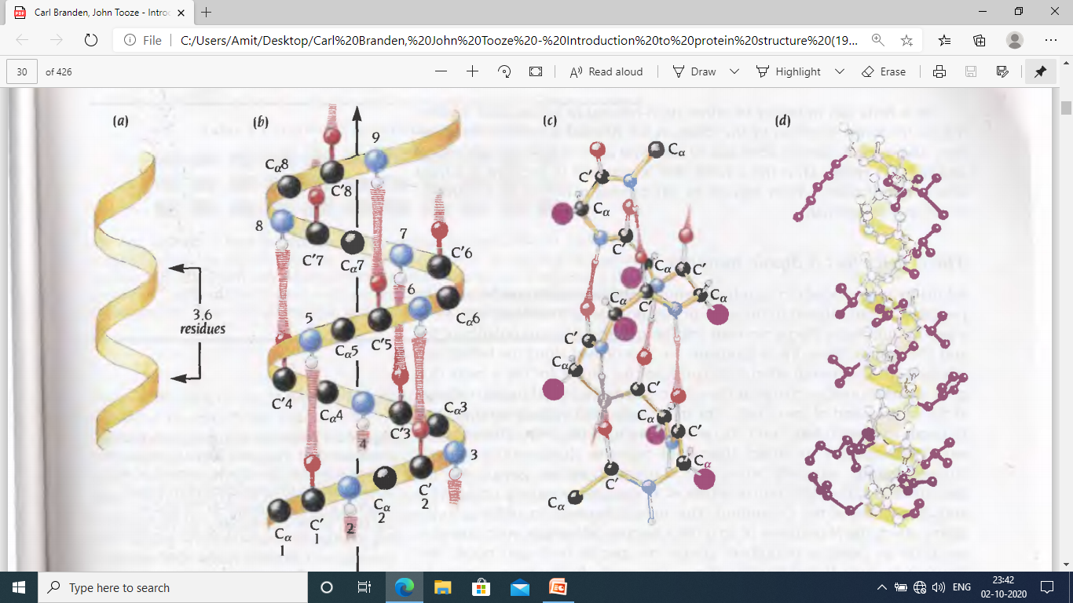
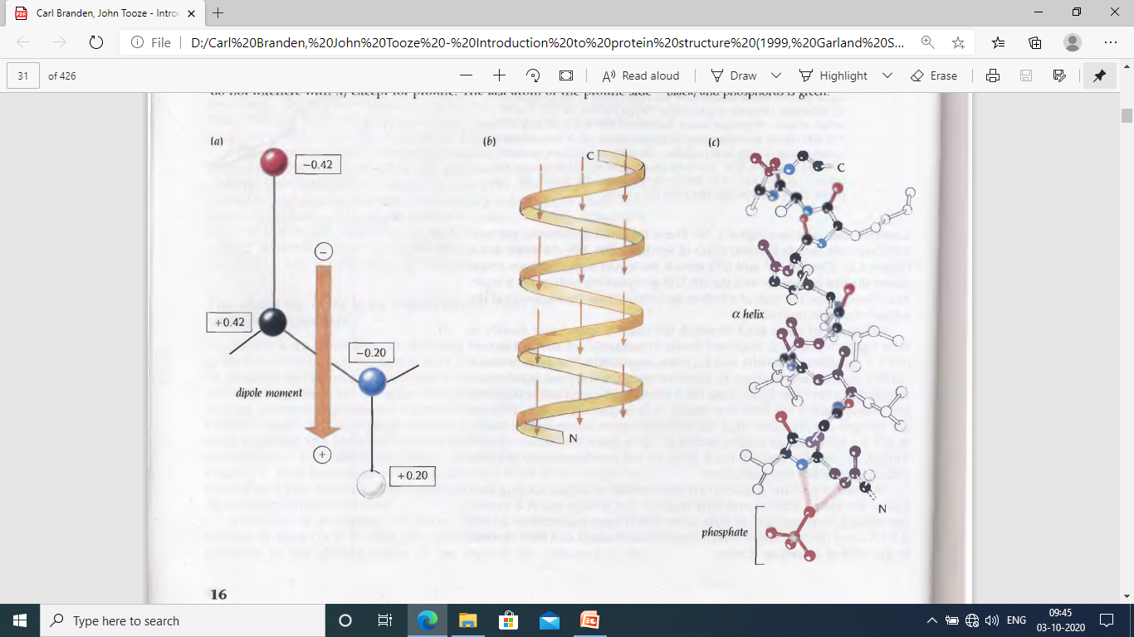
α helix has 3.6 residue per turn with H-bond between C’=O of residue n and NH of residue n+4
Main chain NH and C’=O groups are joined with H-bond except first NH group at N-terminus and C’=O group at C-terminus ⇒ α helix has a dipole moment with magnitude about 0.5–0.7 unit charge at each end of the helix
-vely charged ligands, e.g., PO₄³⁻ , bind at N-terminus
+vely charged ligands bind at C-terminus
α helix can be right or left handed depending on the screw direction of the chain. In proteins it is always right handed. Left handed α helix is not allowed for L-amino acids due to close approach of the side chains and CO group.
α helices are almost always at the surface of proteins
It also occurs occasionally with 3 to 5 residues
α helix
1.5 Å rise per residue
Length of helix: 4/5 to 40 residues
π helix: H-bond to residues n+5 ⇒ more loosely coiled than α helix
3₁₀ helix: H-bond to residues n+3 ⇒ more tightly coiled than α helix

Slide 13
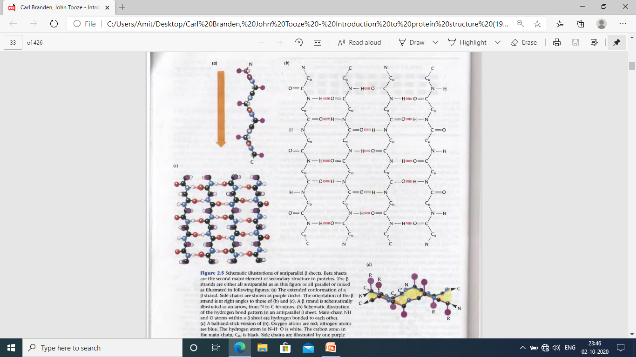
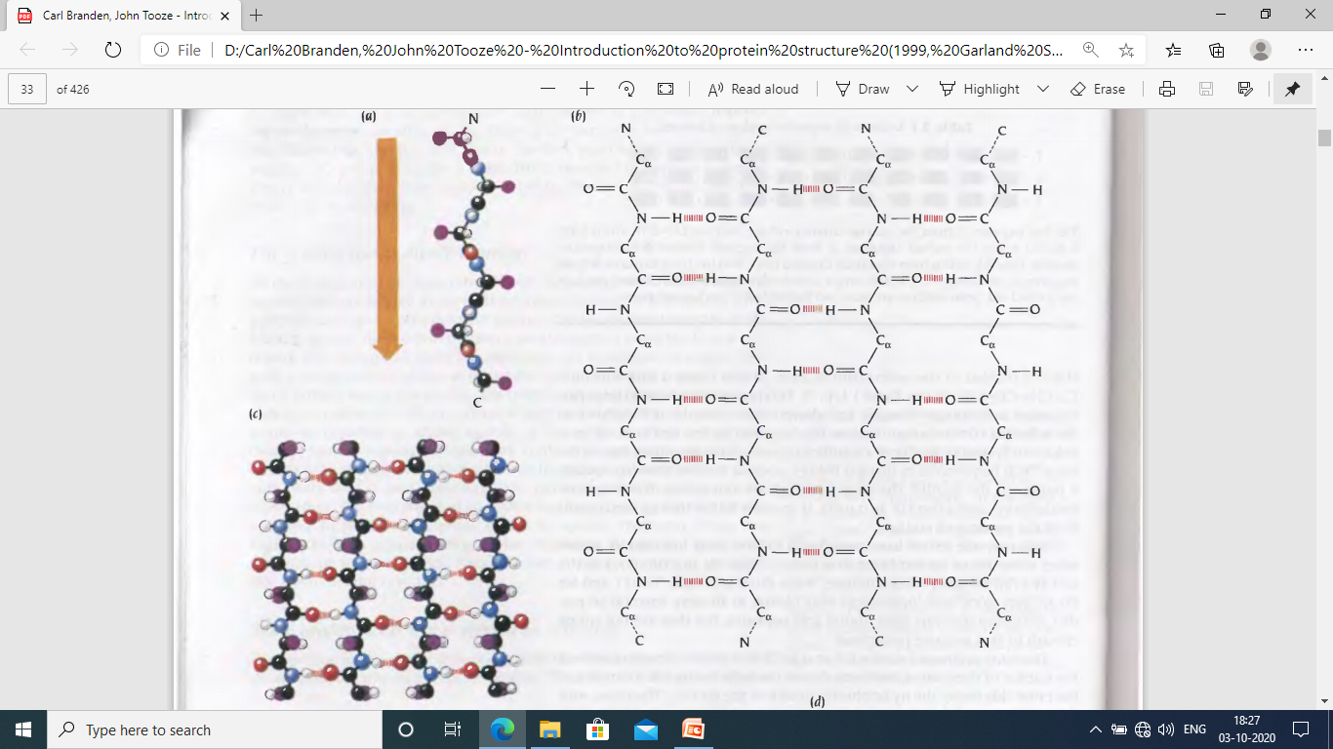
β sheet is built up from a combination of several regions of the polypeptide chain (in contrast to α helix, built up from one continuous region)
β strands are usually 5 to 10 residue long
β strands are adjacent in the β sheets where H-bonds form between C’=O group of one β strand and NH group of adjacent β strand
β strand
Antiparallel β sheet: Amino acids in the successive strands run in alternating directions, amino terminal to carboxy terminal followed by carboxy terminal to amino terminal and so on
Antiparallel β sheet has narrowly spaced H-bond pairs that alternate with widely spaced pairs
Except two flanking β strands of β sheet, all possible main chain H-bonds are formed across constituent β strands
Antiparallel β sheet
β sheets formed from several β strands are pleated with C_{α} atoms successively a little above and below the plane of β sheet
Pleat of a antiparallel
β sheet

Slide 14
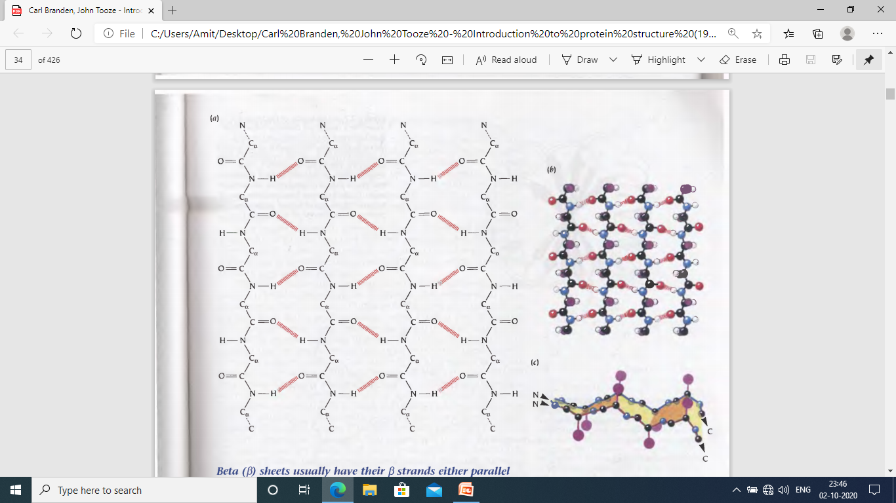
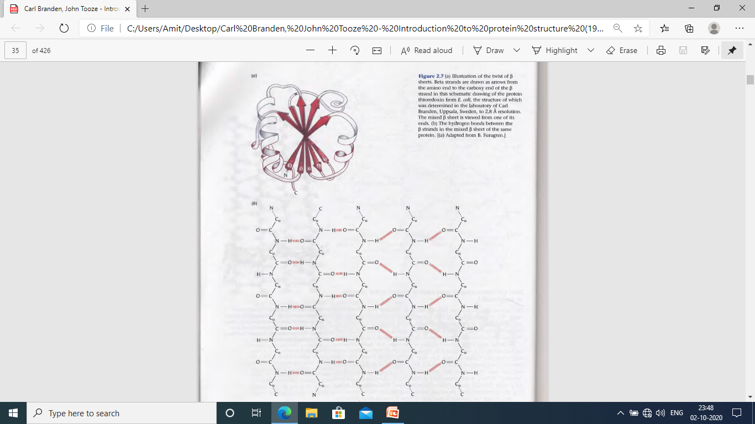
β strands can combine into mixed β sheets with some β strand pairs parallel and some antiparallel
Parallel β sheet
Amino acids in all strands run in same directions
Evenly spaced H-bonds that bridge β strands at an angle
Pleat of a parallel β sheet
Protein thioredoxin from E.coli

Slide 15
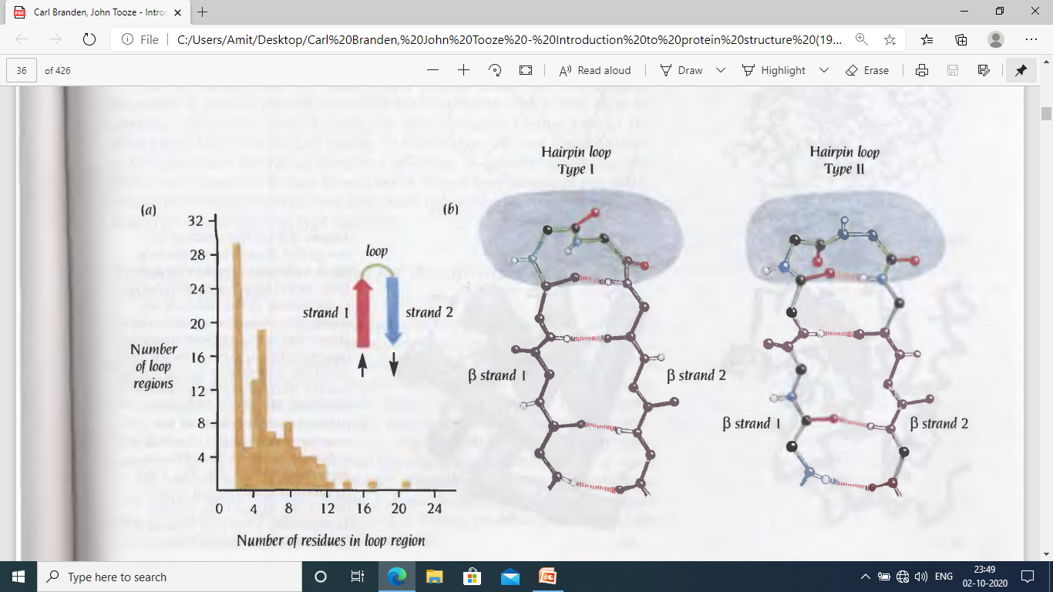
In protein structure the secondary strucral elements α helices and β strands are connected by loop regions of various lengths and irregular shapes. The loops are at the surface of the molecule and are rich in polar hydrophilic residues. The main chain C’=O and NH groups are exposed to the solvents and form H-bonds with water.
Frequency of hairpin loops of different lengths in 62 proteins
Turn to the left
Turn to the right
Loops that connect two adjacent β strands are called hairpin loops or reverse turns.
Long loop regions are flexible and can frequently adopt several different conformation
Loop regions participates in forming binding sites and enzyme active sites
Long loops are in many cases susceptible to proteolytic degradation. However it can be protected by binding metal ions, such as calcium ion

Slide 16
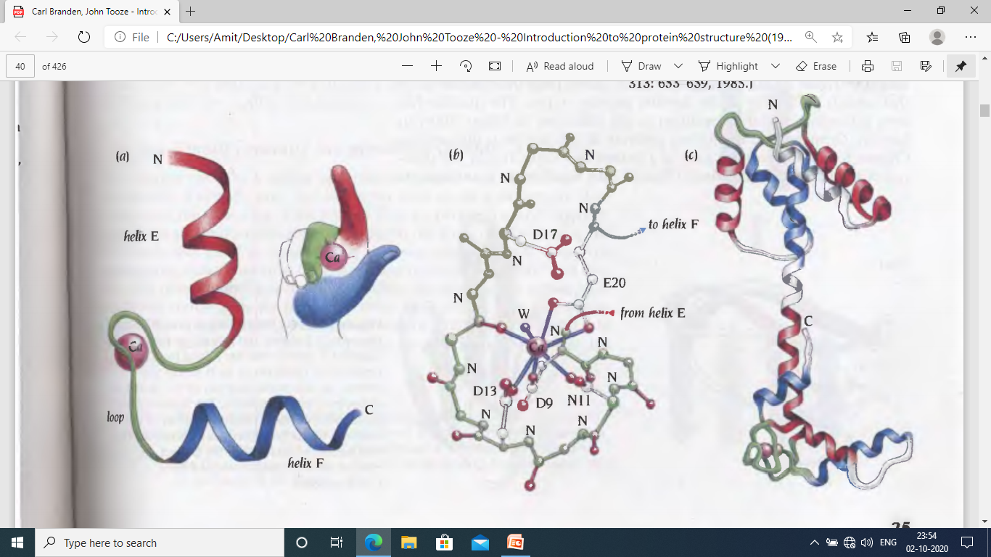
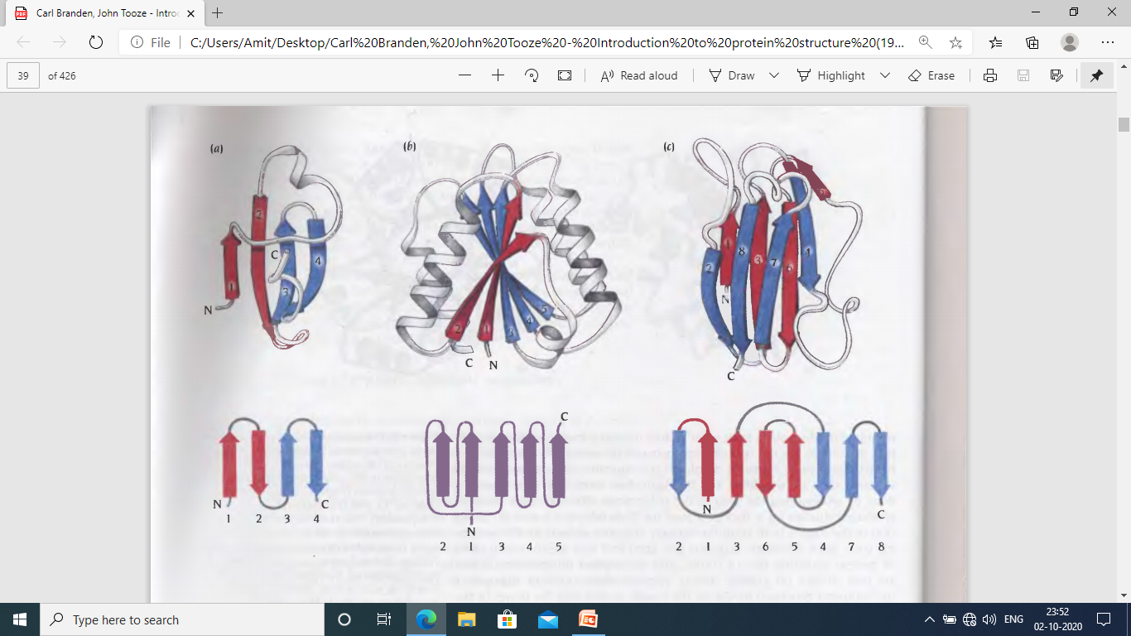
Motif: Combination of a few secondary structural elements with a specific geometric arrangement in protein structure is defined as Motif or super-secondary structure. It might have specific function.
Two α helices joined by a loop region (helix-loop-helix motif).
Several different calcium binding protein has this motif, such as parvalbumin, protein troponin-C
This motif comprises two right handed helices, fifth (E) and sixth (F) helices in the protein structure and a loop of 12 residues.
Loop region binds calcium ion and the motif provides a scaffold that holds calcium ligands to bind and release calcium during muscle relaxation.
Topology diagram of protein structure: It is the simplified schematic representation of the secondary structure elements, especially β sheet including the number of strands, their relative directions (parallel or antiparallel), and the way strands are connected along polypeptide chain (strand order). However the twist of β sheet is not represented in the topology diagram.
Antiparallel β strands in aspartate transcarbamoylase
Parallel β strands in redox protein flavodoxin

Slide 17
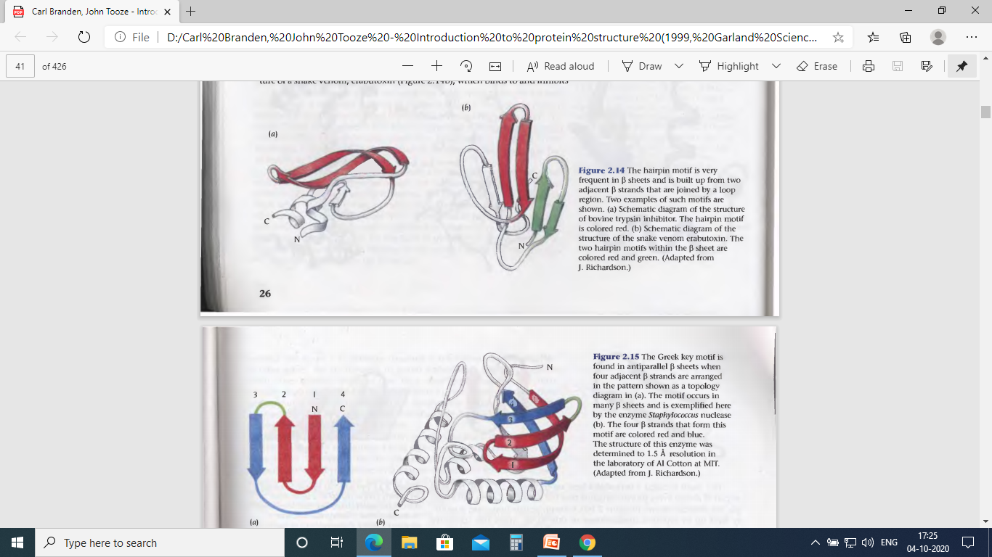
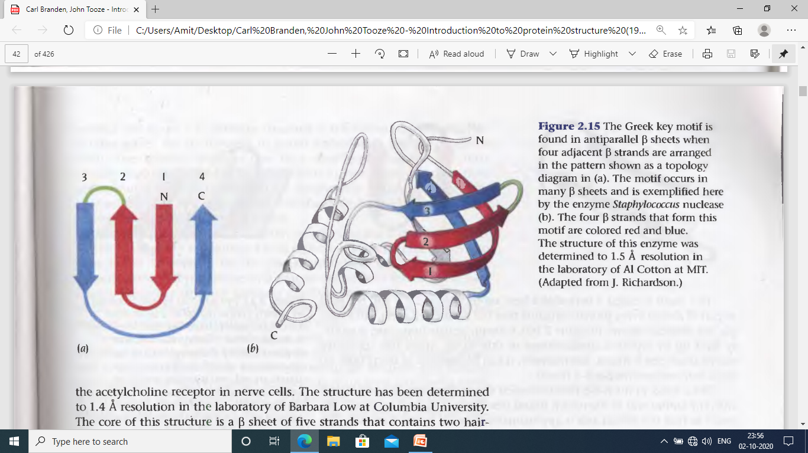
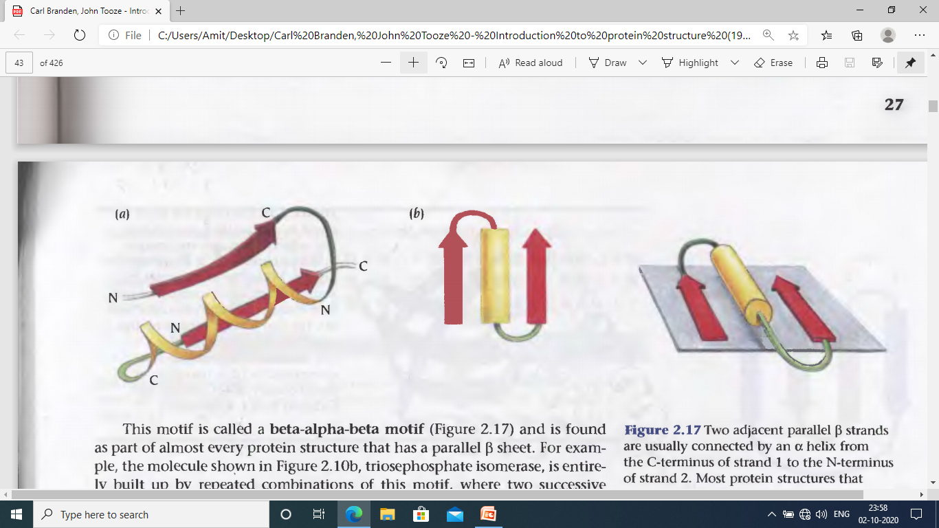
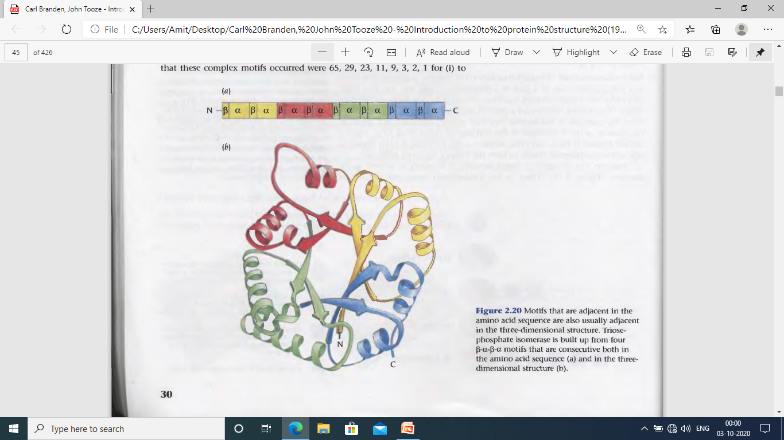
Hairpin β motif:
Two adjacent antiparallel β strands joined by a loop generally from 2 to 5 residues
It is present in most antiparallel β structure such as snake venom erabutoxin
which binds to and inhibits the acetylcholine receptor in nerve cells
Greek key motif:
Four adjacent antiparallel β strands are frequently arranged in a pattern similar to
the repeating unit of an ornamental pattern, used in ancient Greece. In protein
structure the motif is called Greek key.
Staphylococcus nuclease, an enzyme that degrades DNA, has Greek key motif
Erabutoxin
Staphylococcus nuclease
β-α-β motif: It consists of two parallel β strands, an α helix and two loops
Two adjacent parallel β strands that are consecutive in amino acid
sequence are joined through an α helix. α helix in β-α-β motif connects
carboxy end of one β strands with amino end of the next β strand.
The polypeptide chain turns twice using loop regions and it varises
from one to two residues to hundred.
This motif is found out in almost every protein structure having
parallel β sheet such as triosephosphate isomerase
Triosephosphate isomerase

Slide 18
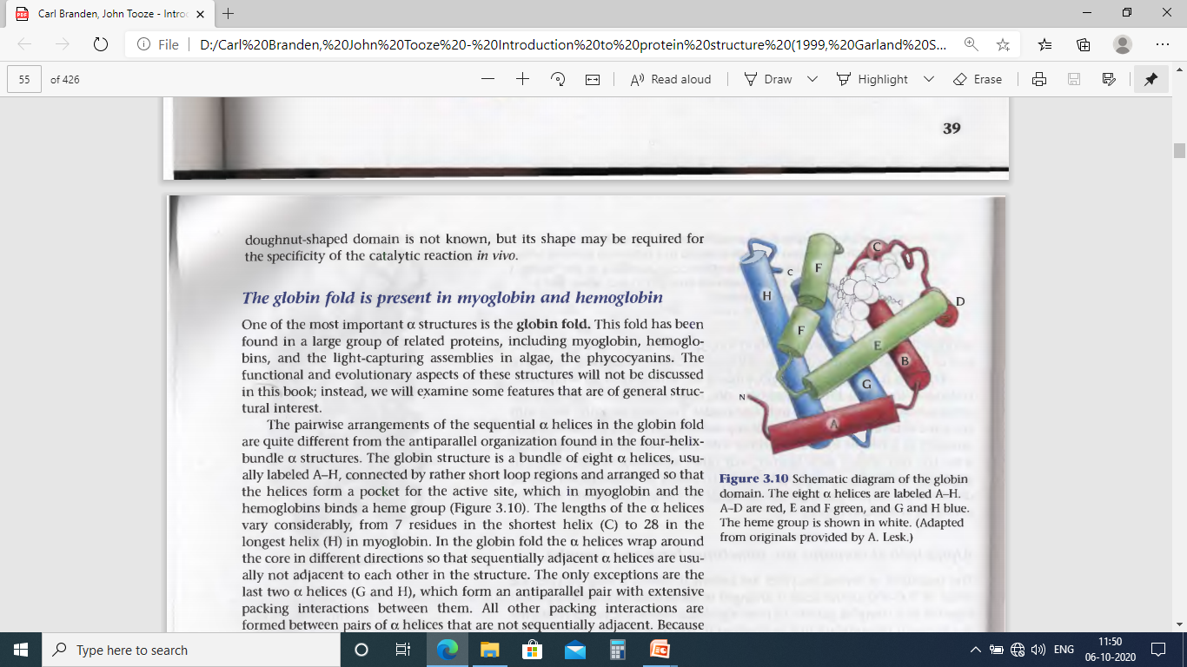
Structural hierarchy of protein molecule:
Primary structure – Amino acid sequence along a polypeptide chain; Two proteins with significant similarity in the primary structure are said to be homologous
Secondary structure – Secondary structure occurs mainly as α helices and β sheets. Secondary structure elements arrange themselves in simple motif
Tertiary structure – Several motifs combine to form a compact globular structure called domain which is the fundamental unit of the tertiary structure. Tertiary structure is formed by the packing of domains.
Quaternary structure – Protein molecules with only one chain are called monomeric and proteins with multiple polypeptide chains are called multimeric proteins. Quaternary structure of a protein consists of several polypeptide chains that are associated into a multimeric molecule.
α domain structure: Globular protein – Myoglobin, Hemoglobin
Short α helices are connected by loop regions and packed together to produce a hydrophobic core, while hydrophilic residues on the surface make the protein soluble in water.
Globin fold: A bundle of eight α helices, usually labeled as A-H, arrange in way that a pocket, an active site is formed, where in myglobin and hemoglobin a heme group is bound. There are 7 residues in the shortest helix ‘C’ and 28 residues in the longest helix ‘H’ of myoglobin.
In membrane bound proteins, the region inside the membranes are frequently α helices whose surfaces are covered by hydrophobic side chains suitable for the hydrophobic environment inside the membranes.

Slide 19
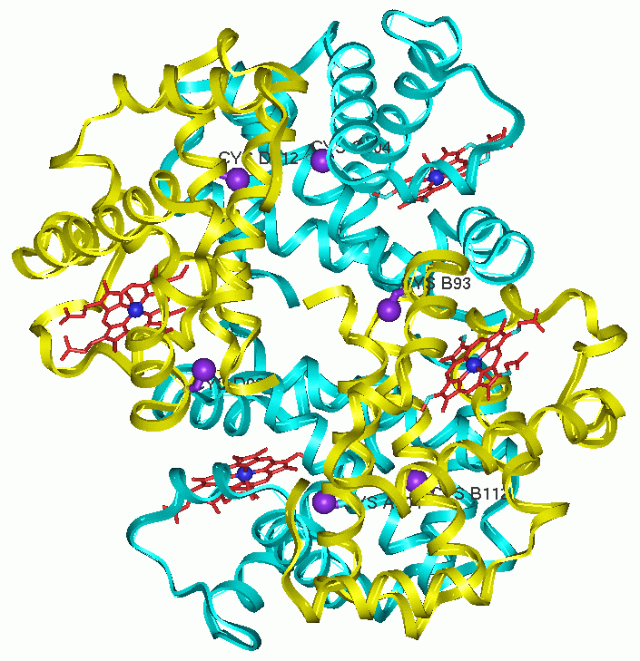
Normal Human Hemoglobin (α₂β₂)
β chain
α chain
Hb α chain
15125Da
Hb β
15866 Da
1.2E6
8E5
Deconvoluted
mass spectra
4E5
0
α chain
15000
15250
15500
15750
β chain

Slide 20
Structural hierarchy of protein molecule:
Primary structure – Amino acid sequence along a polypeptide chain; Two proteins with significant similarity in the primary structure are said to be homologous
Secondary structure – Secondary structure occurs mainly as α helices and β sheets. Secondary structure elements arrange themselves in simple motif
Tertiary structure – Several motifs combine to form a compact globular structure called domain which is the fundamental unit of the tertiary structure. Tertiary structure is formed by the packing of domains.
Quaternary structure – Protein molecules with only one chain are called monomeric and proteins with multiple polypeptide chains are called multimeric proteins. Quaternary structure of a protein consists of several polypeptide chains that are associated into a multimeric molecule.
α domain structure: Globular protein – Myoglobin, Hemoglobin
Short α helices are connected by loop regions and packed together to produce a hydrophobic core, while hydrophilic residues on the surface make the protein soluble in water.
Globin fold: A bundle of eight α helices, usually labeled as A-H, arrange in way that a pocket, an active site is formed, where in myglobin and hemoglobin a heme group is bound. There are 7 residues in the shortest helix ‘C’ and 28 residues in the longest helix ‘H’ of myoglobin.
In membrane bound proteins, the region inside the membranes are frequently α helices whose surfaces are covered by hydrophobic side chains suitable for the hydrophobic environment inside the membranes.

Slide 21
Normal Human Hemoglobin (α₂β₂)
β chain
α chain
Hb α chain
15125Da
Hb β
15866 Da
1.2E6
8E5
Deconvoluted
mass spectra
4E5
0
α chain
15000
15250
15500
15750
β chain

Slide 22

LC/ESI-MS of Normal Human Hemoglobin
TIC of Hb
Hb α chain
15125Da
TIC of Hb
α chain
20.5
21.2
1.2E6
Hb β
15866 Da
β chain
4E7
8E5
Deconvoluted
mass spectra
2E7
4E5
0
0
20
21
22
23
min
15000
15250
15500
15750
α(+20)
β(+17)
20
18
Charge states of Hb α
Mass Spectra of Hb
2E5
100
934.2
α(+16)
21
16
757.2
1E5
15
α(+15)
13
Intensity (%)
946.3
β(+14)
0
600
800
1000
1200
1400
19
17
Charge states of Hbβ
1009.3
α(+13)
2E5
40
21
1134.3
1164.4
1E5
14
0
0
800
1000
1200
m/z
600
800
1000
1200
1400

Slide 23
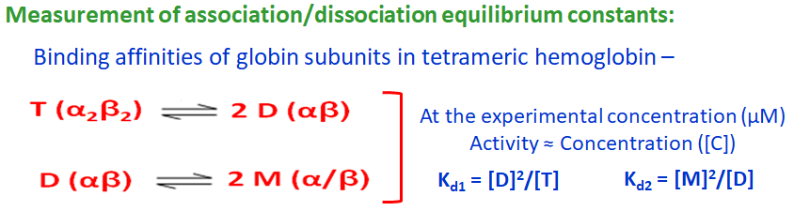
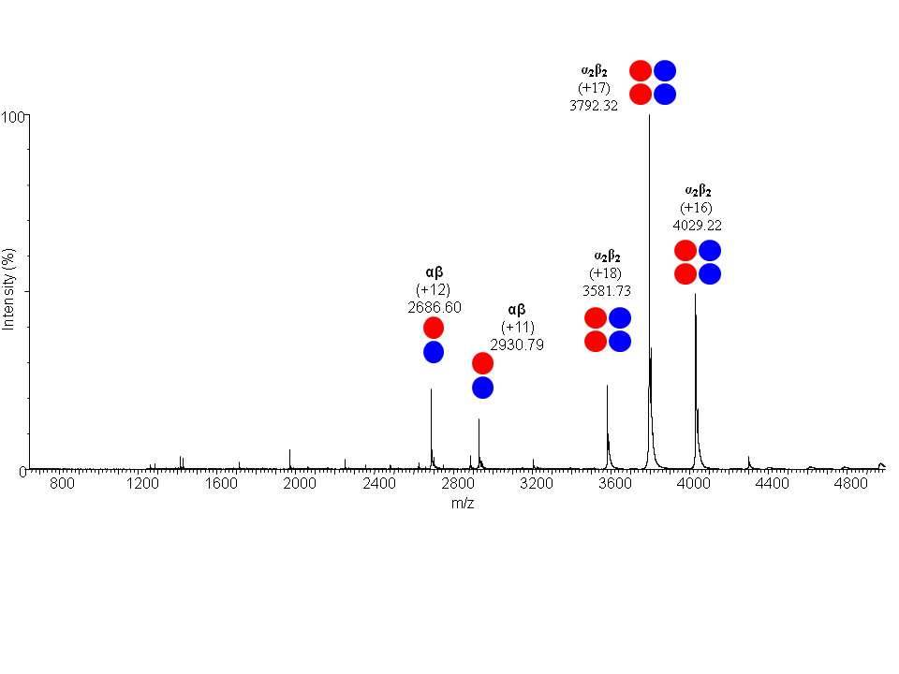
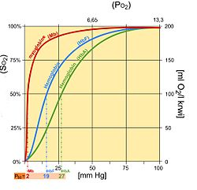
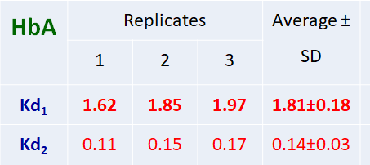
Human hemoglobin
α globin chain
β globin chain
α
(+8)
1969.4
α
(+7)
2250.7
(25 μM Human hemoglobin in 10mM NH₄Ac; pH 7.4; Temp 310 K)
Journal of Structural Biology, 2019, https://doi.org/10.1016/j.jsb.2019.09.003

Slide 24
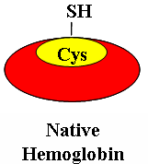
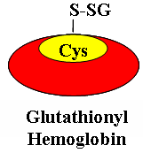
Posttranslation modification of Human Hemoglobin
Glutathionylation :
GSSG
Oxidative stress
GSH
GSSG
Antioxidant
Glutathionyl Hemoglobin as a marker of oxidative stress (quantified using LC/ESI-MS platform):
Chronic renal failure Clin Biochem, 2007, 40, 986-94
Iron Deficiency Anemia Acta Haematologica, 2012;127, 26-30
Major Depressive Disorder Indian Journal of Medical Research, 2019, 149, 497-502
Multiple Sclerosis, Diabetes, Cardio Vascular Disease
100
GSHb
α globin chain - Cys104
β globin chain - βCys93 and βCys112
Glutathionylation occurs at βCys93
Clin Biochem, 2007, 40, 986-94
Hb
α globin chain - Cys104
β globin chain - βCys93 and βCys112
Glutathionylation occurs at βCys93
Clin Biochem, 2007, 40, 986-94
P₅₀ = 16.4 GSHb
50
sO₂ (%)
P₅₀ = 27.01 Hb
P₅₀ = 27.01 (Normal Human Hemoglobin)
P₅₀ = 16.4 (Glutathionyl Hb binds to O₂ six fold tighter)
0
0
50
100
pO₂ (mmHg)

Slide 25
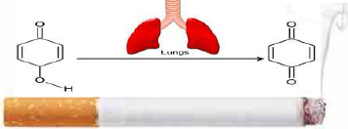
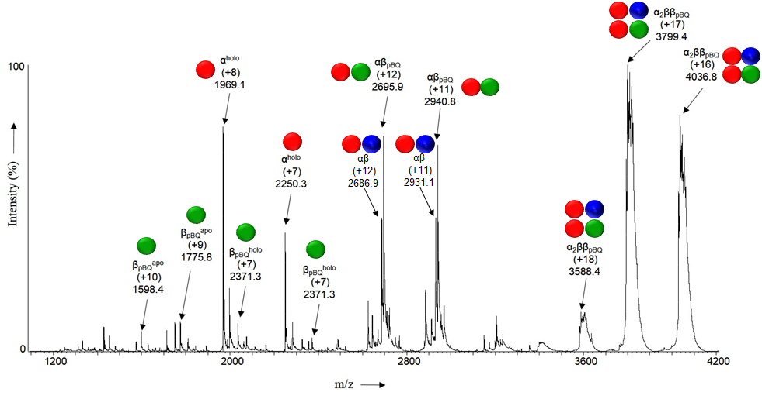
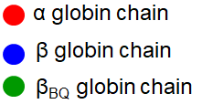
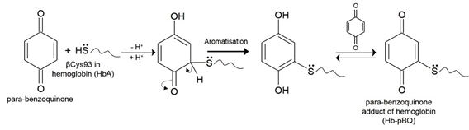
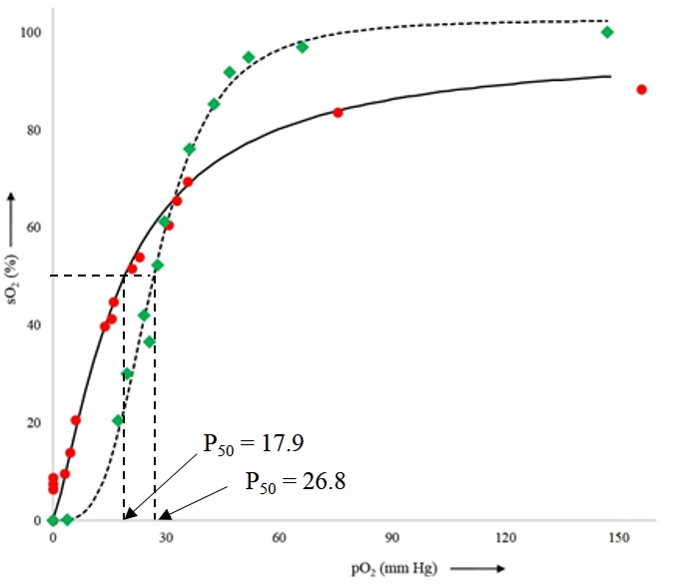
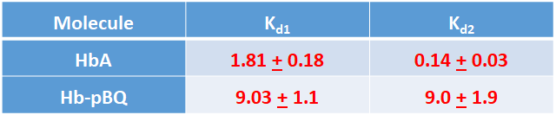
pBQ combines with βCys93
HbpBQ increases with no. of cigarette smoked per day
Toxicology Report, 2016, 3, 295
Normal Hb
Hb-pBQ (cigarette smoke)
P₅₀ = 17.9
(significantly tighter O₂ binding)
2.6 folds decrease in Hill coeff
In smoker’s blood, conjugation of pBQ with hemoglobin results in reduced O₂ supply to the tissues ⇒ HYPOXIA !!!
J Am Soc Mass Spectrom, 2018, 29, 2048-2058

